Slide 1
Arabic Dialect Identification

Slide 2
TABLE OF CONTENTS
01
02
03
Introduction
EDA & Feature Engineering
Classification Algorithms
04
Results and Discussion

Slide 3
INTRODUCTION
Arabic is a language spoken by over 420 million people across the globe, and it has a rich linguistic heritage with significant variations in dialect and script.

Slide 4
Diversity of Arabic Dialects
01
05
Libya
Egypt
Libyan Arabic, influenced by the Mediterranean, features simplified grammar and distinct lexicon.
Egyptian Arabic, widely influential, blends ancient Egyptian, Coptic, and Arabic elements, dominant in media.
02
04
Lebanon
Sudan
Lebanese Arabic, expressive and regionally varied, shines in arts and cinema.
03
Sudanese Arabic, diverse and influenced by African languages, varies regionally.
Morocco
Moroccan Arabic, rich in heritage, showcases unique phonology and vocabulary.

Slide 5
EDA & Feature Extraction
1
3
Normalization: Remove diacritics, handle elongation.
Tokenization: Split text into tokens.
2
4
Stop Words Removal: Filter out common, insignificant words.
Feature Extraction:
TF-IDF & Word Embeddings

Slide 6
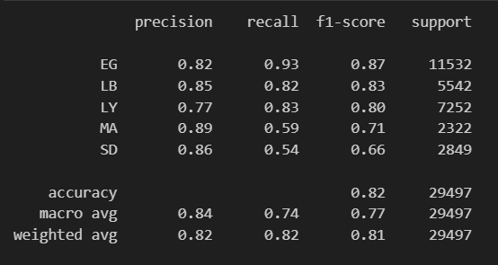
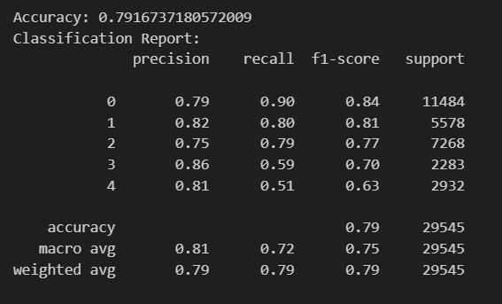
Machine Learning Approaches
Logistic Regression: Simple yet effective using TF-IDF features.
Support Vector Machines (SVM): Effective for high-dimensional spaces using TF-IDF features.

Slide 7

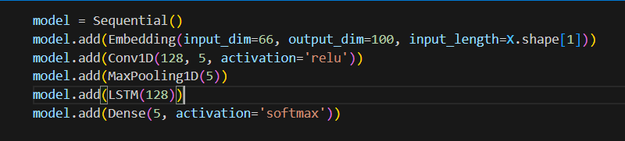
Deep Learning Approaches
LSTM with CNN Layer: Combines sequential and spatial features, providing the best results.

Slide 8

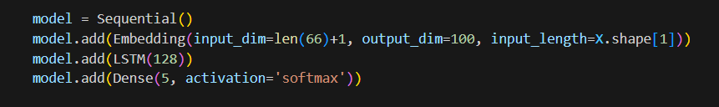
Deep Learning Approaches
LSTM (Long Short-Term Memory): Captures sequential dependencies.
Using word embedding
We observed that the LSTM model combined with a CNN layer performed significantly better on shorter sentences.

Slide 9
Performance Comparison:
Logistic Regression and SVM with TF-IDF: Good baseline performance.
LSTM: Improved performance by capturing sequence dependencies.
LSTM with CNN Layer: Best performance by combining sequential and spatial features.
Challenges:
Class Imbalance: Some categories might have more samples than others.
Dialectal Variations: Variations in the Arabic dialects can affect accuracy.

Slide 10
THANK YOU

